Slide 1



SQL PROJECT ON
PIZZA SALES
"Applied SQL to analyze pizza sales data, identifying trends in sales, customer preferences, and efficiency."

Slide 2
ABOUT THE PROJECT
This SQL project analyzes pizza sales data from Pizza Hut to uncover sales patterns and trends. The dataset comprises four tables:
1. order_details: Contains order-specific details, including `order_details_id`, `order_id`, `pizza_id`, and `quantity`.
2. orders: Provides information on each order with `order_id`, `order_date`, and `order_time`.
3. pizza_types: Lists pizza types with `pizza_type_id`, `name`, `category`, and `ingredients`.
4. pizzas: Includes details on individual pizzas with `pizza_type_id`, `name`, `category`, and `ingredients`.
The project involves answering specific questions to understand the sales patterns of pizzas at Pizza Hut, leveraging SQL queries to analyze trends, customer preferences, and operational metrics. The insights gained help in evaluating sales performance and making data-driven decisions for business improvements.

Slide 3
PIZZA SALES DATASET
1. order_details
Columns:
order_details_id: Unique identifier for each order detail.
order_id: Links to orders, identifying the order.
pizza_id: Links to pizzas, identifying the specific pizza.
quantity: Number of units of the pizza ordered.
Purpose: Captures details of each pizza ordered, including quantity.
2. orders
Columns:
order_id: Unique identifier for each order.
order_date: Date of the order.
order_time: Time of the order.
Purpose: Records overall order information, including timing.
3. pizza_types
Columns:
pizza_type_id: Unique identifier for each pizza type.
name: Name of the pizza type.
category: Category of the pizza (e.g., vegetarian).
ingredients: Ingredients used in the pizza.
Purpose: Provides details about different types of pizzas available.
4. pizzas
Columns:
pizza_type_id: Links to pizza_types, identifying the pizza type.
name: Name of the specific pizza.
category: Category of the pizza.
ingredients: Ingredients used in the pizza.
Purpose: Details specific pizzas, complementing pizza_types with additional information.

Slide 4

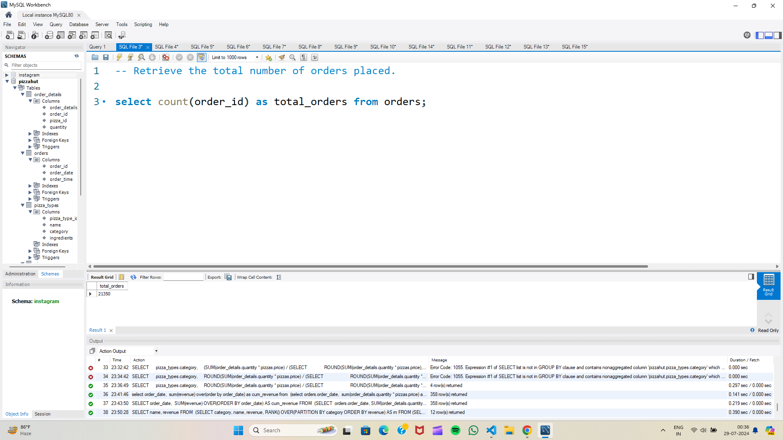
Retrieve the total number of orders placed.

Slide 5
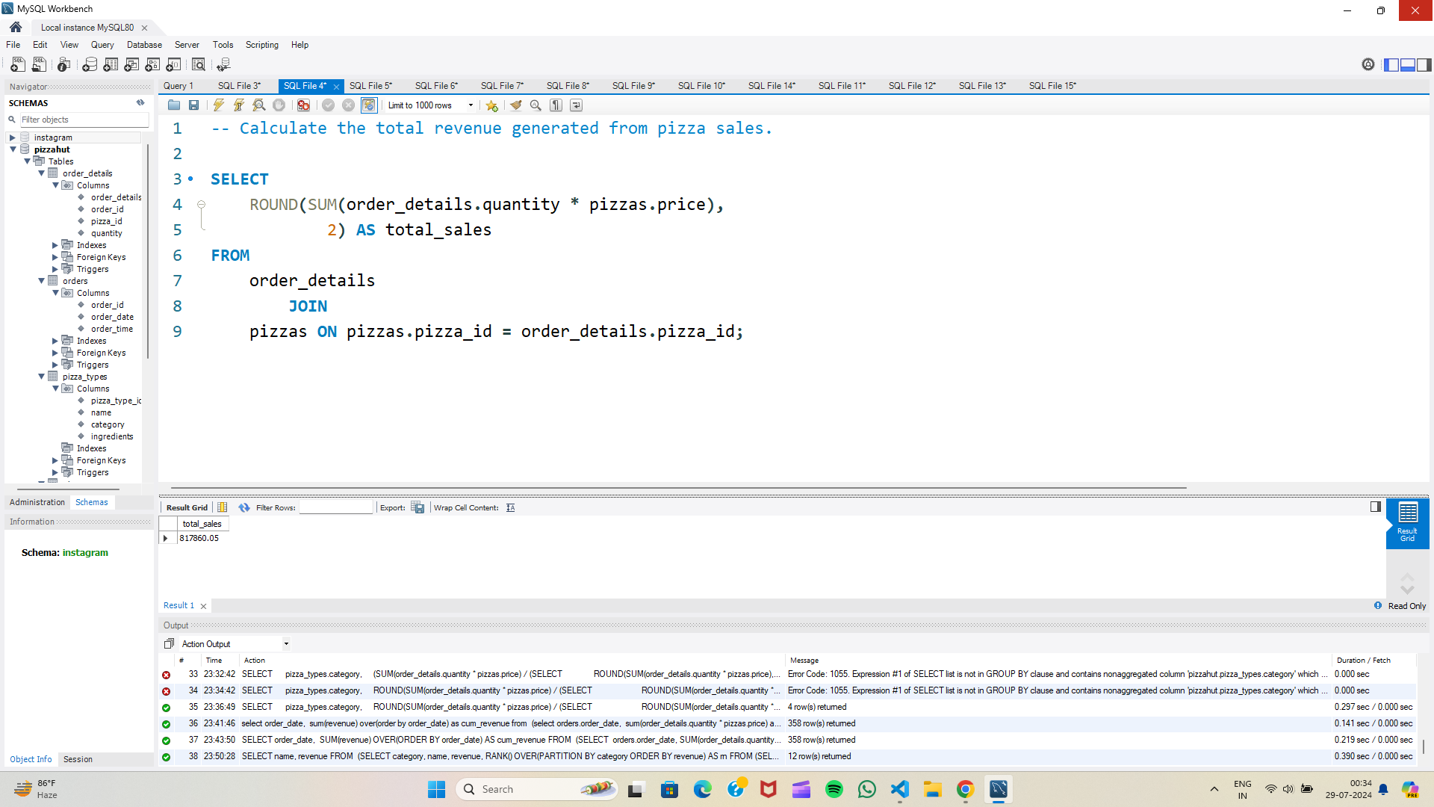
Calculate the total revenue generated from pizza sales.

Slide 6
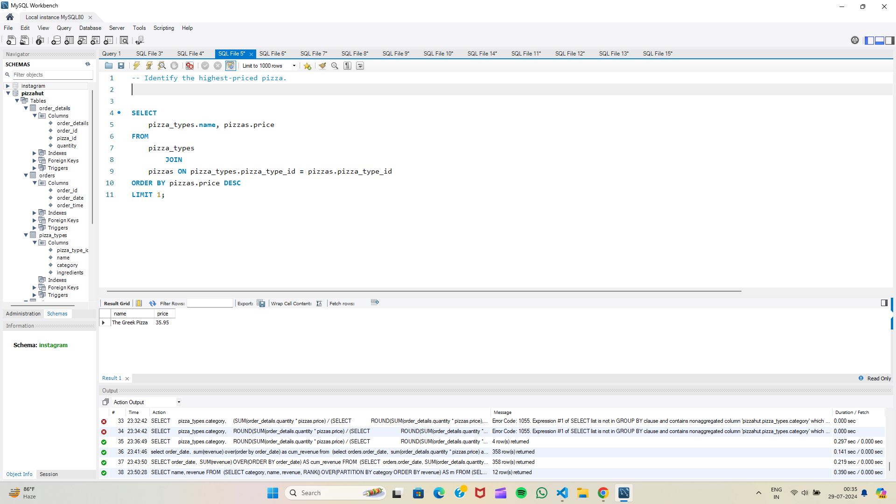
Identify the highest-priced pizza.

Slide 7
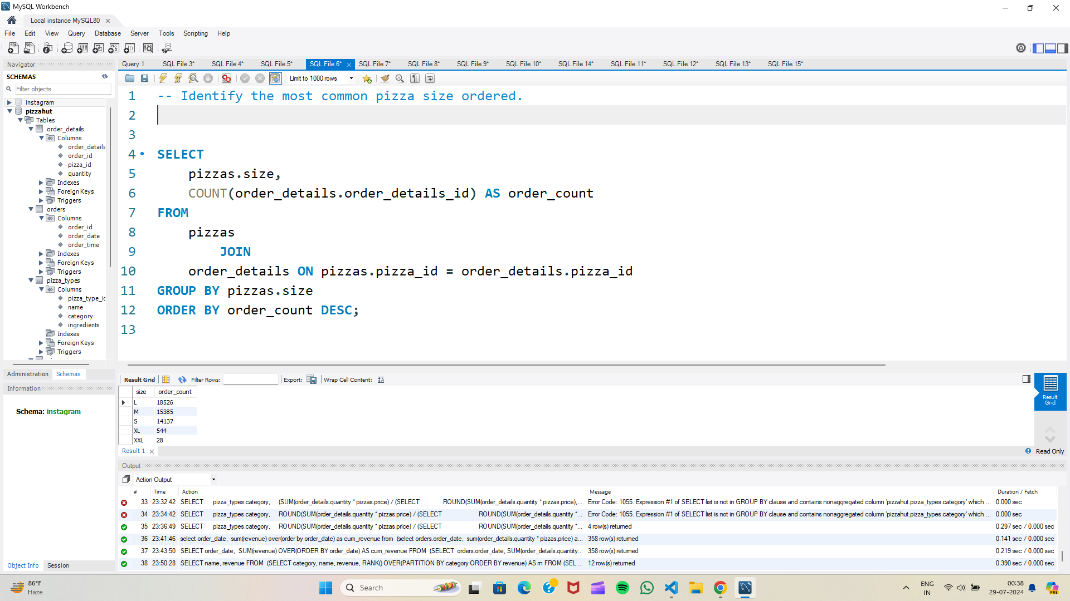
Identify the most common pizza size ordered.

Slide 8
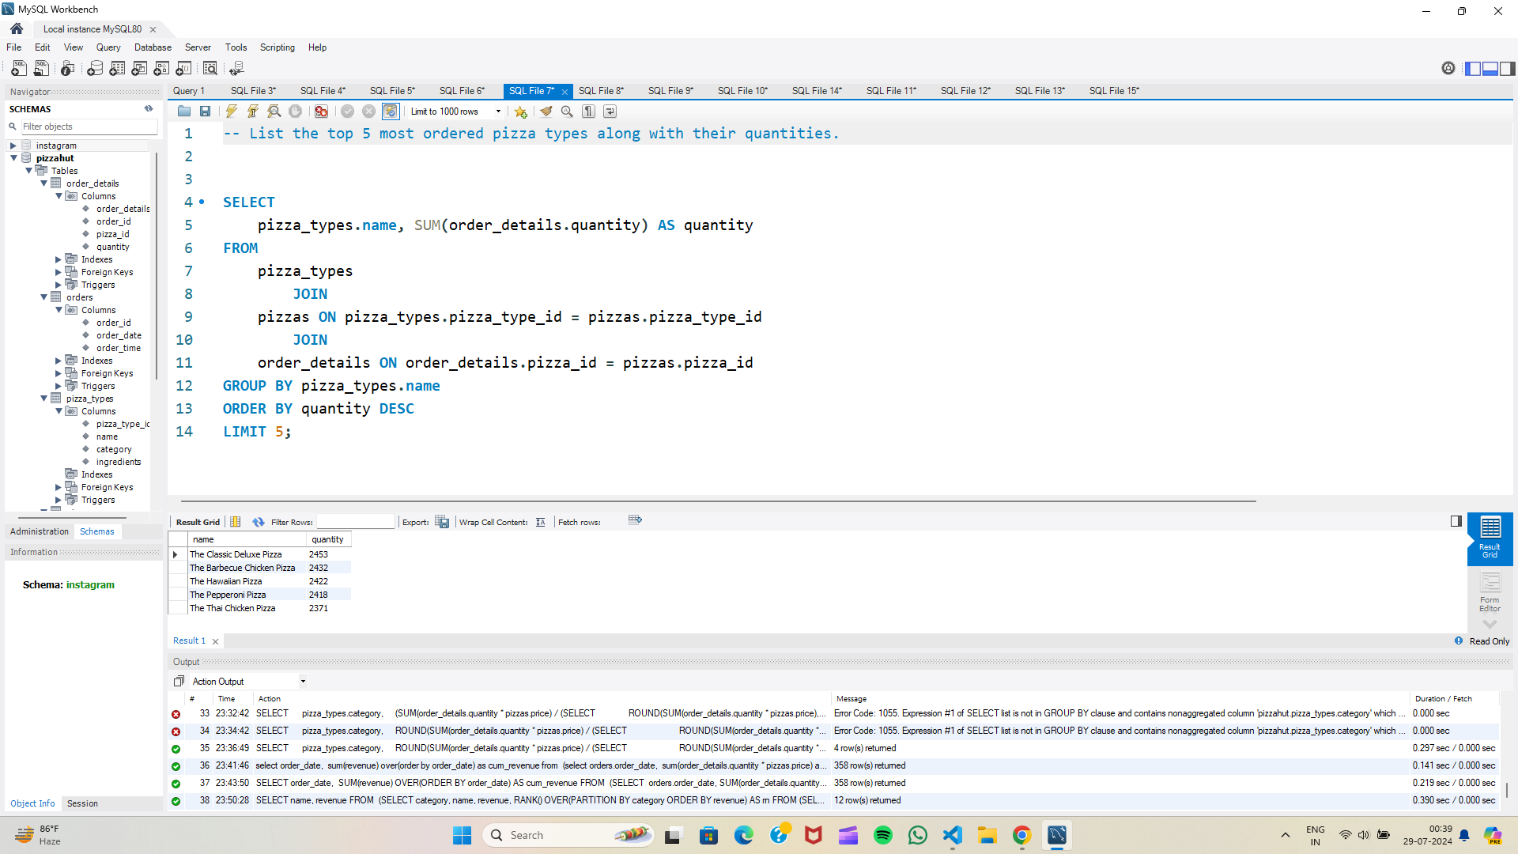
List the top 5 most ordered pizza types along with their quantities.

Slide 9
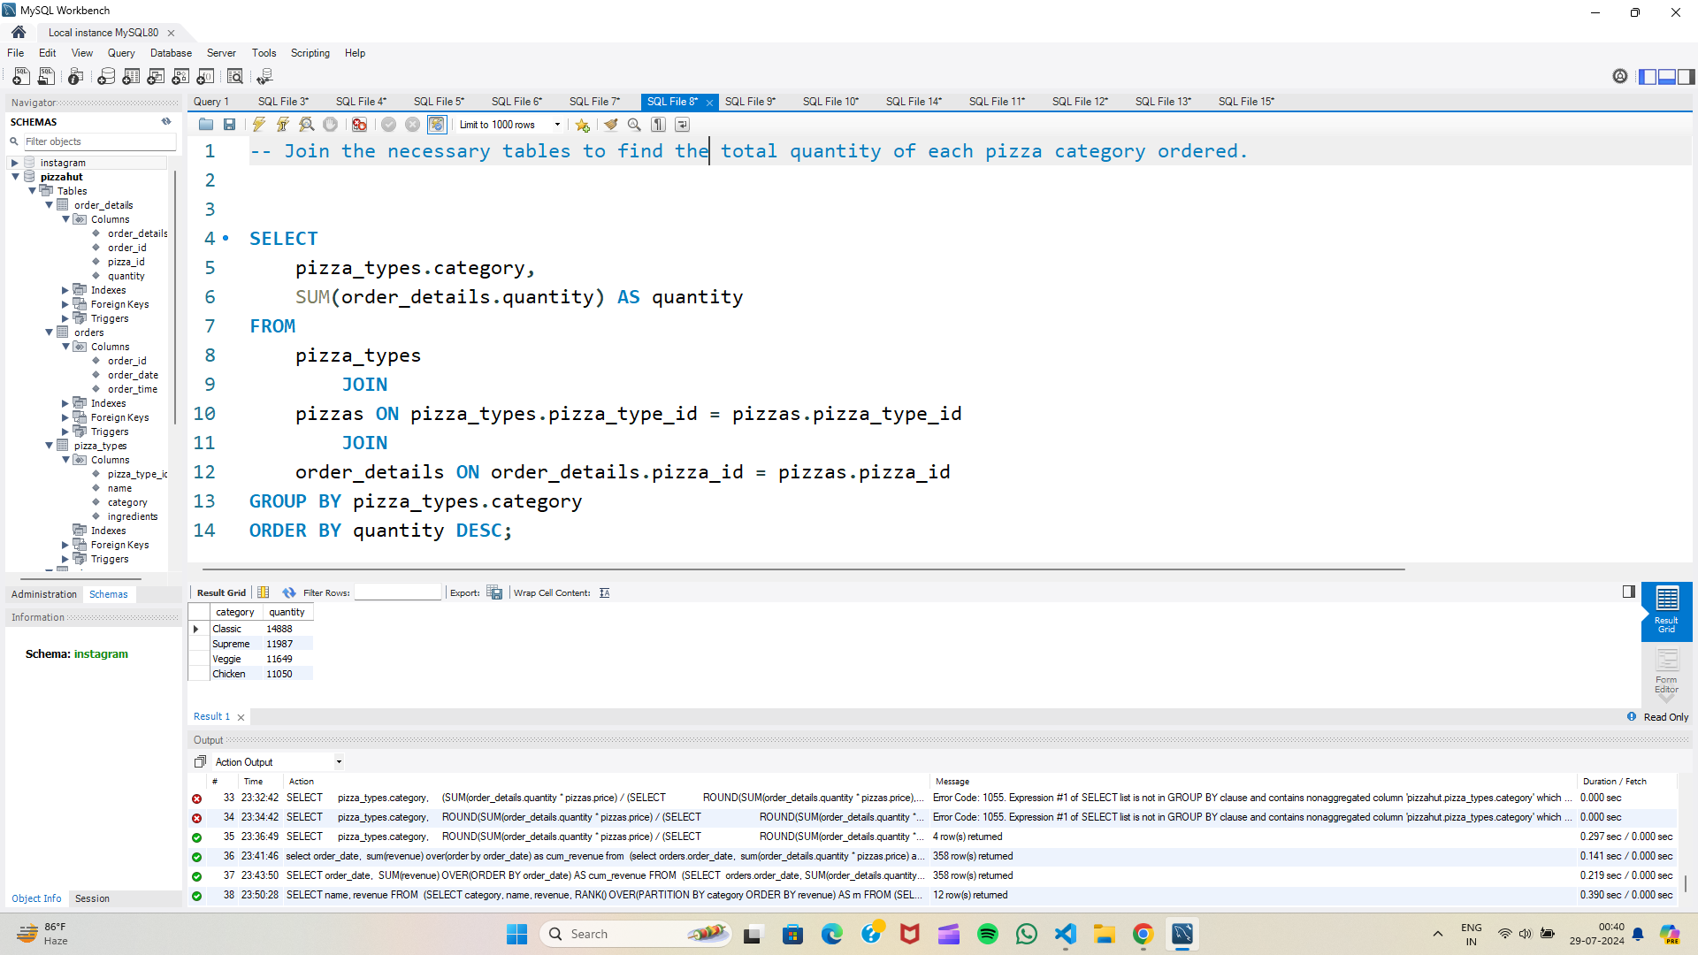
Join the necessary tables to find the total quantity of each pizza category ordered.

Slide 10
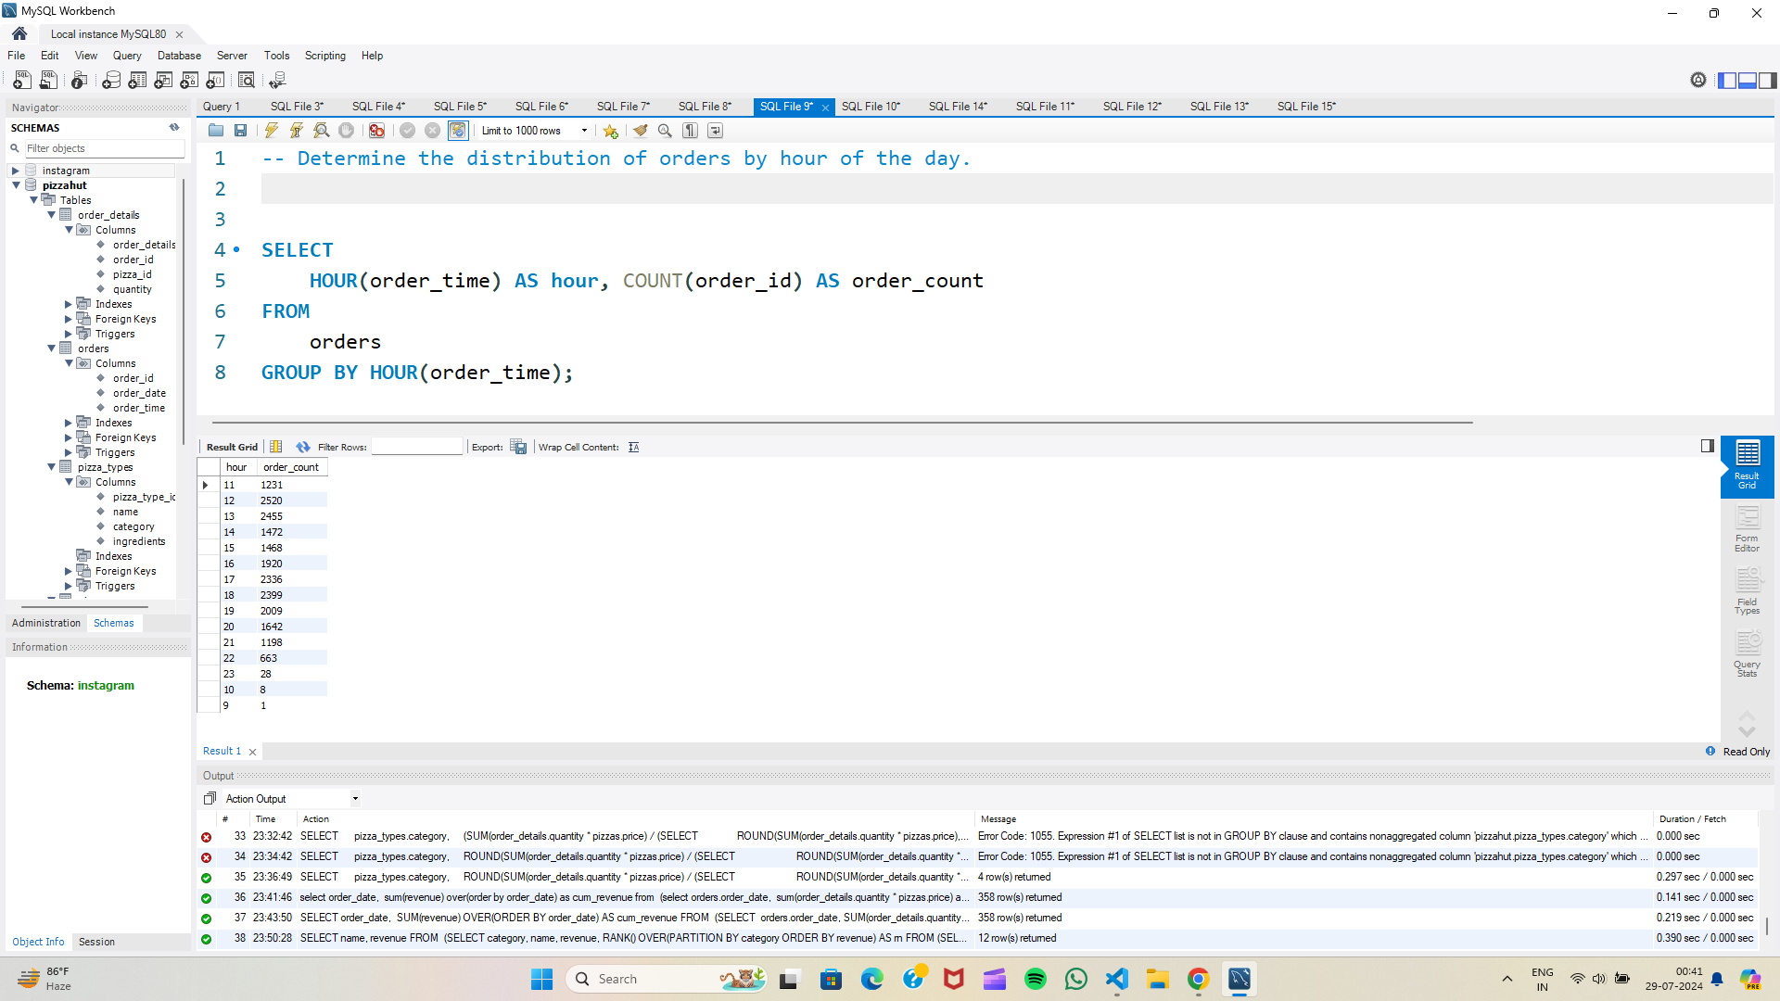
Determine the distribution of orders by hour of the day.

Slide 11
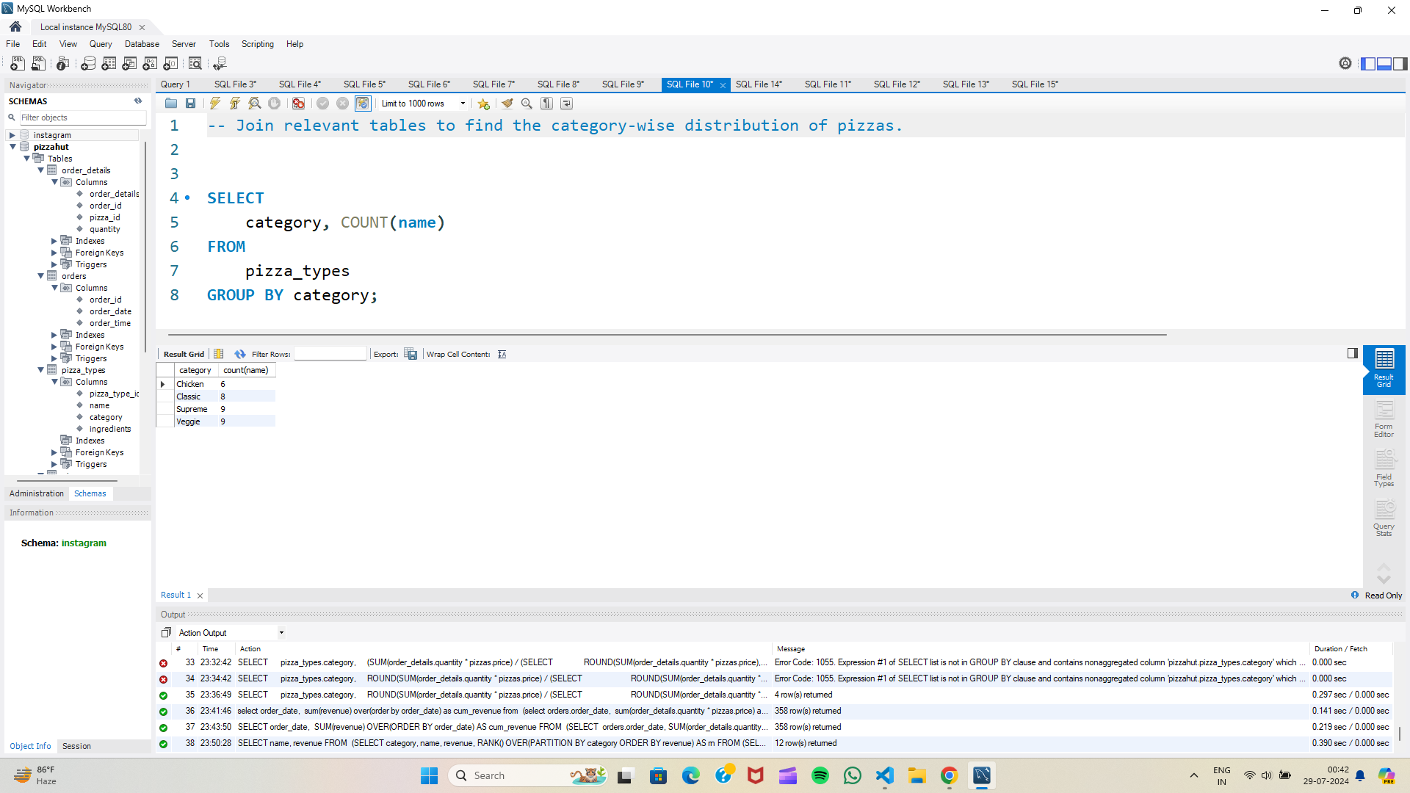
Join relevant tables to find the category-wise distribution of pizzas.

Slide 12
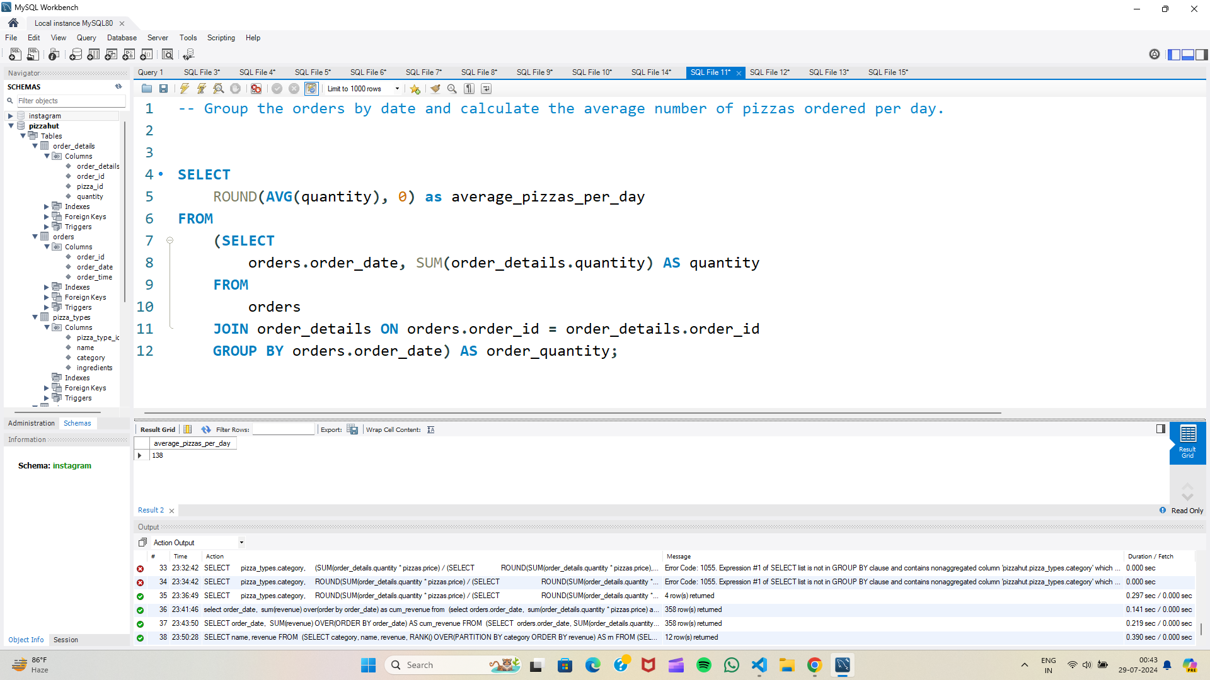
Group the orders by date and calculate the average number of pizzas ordered per day.
3

Slide 13
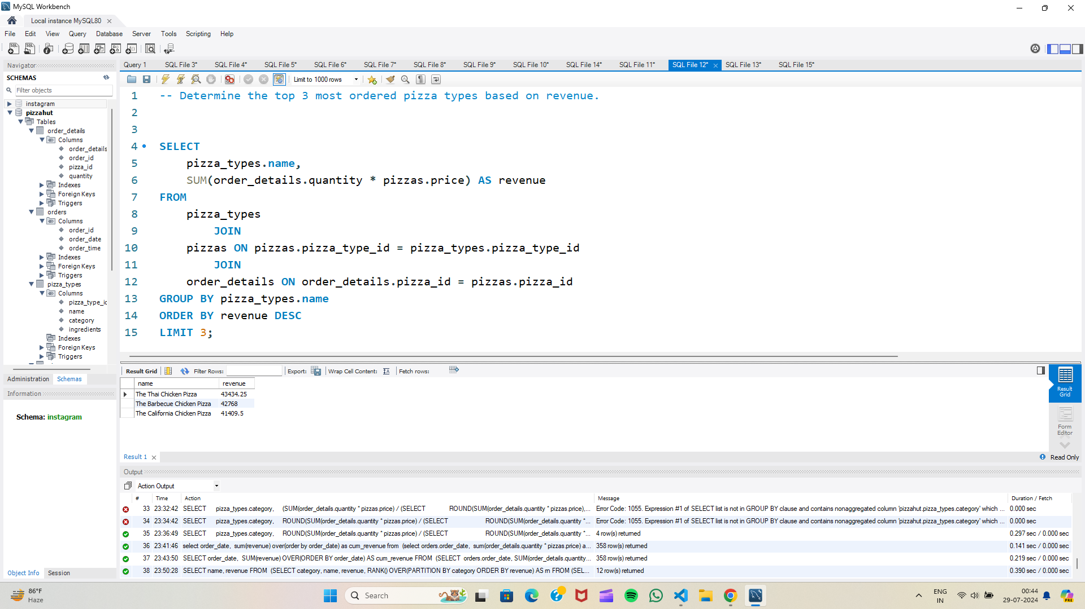
Determine the top 3 most ordered pizza types based on revenue.

Slide 14
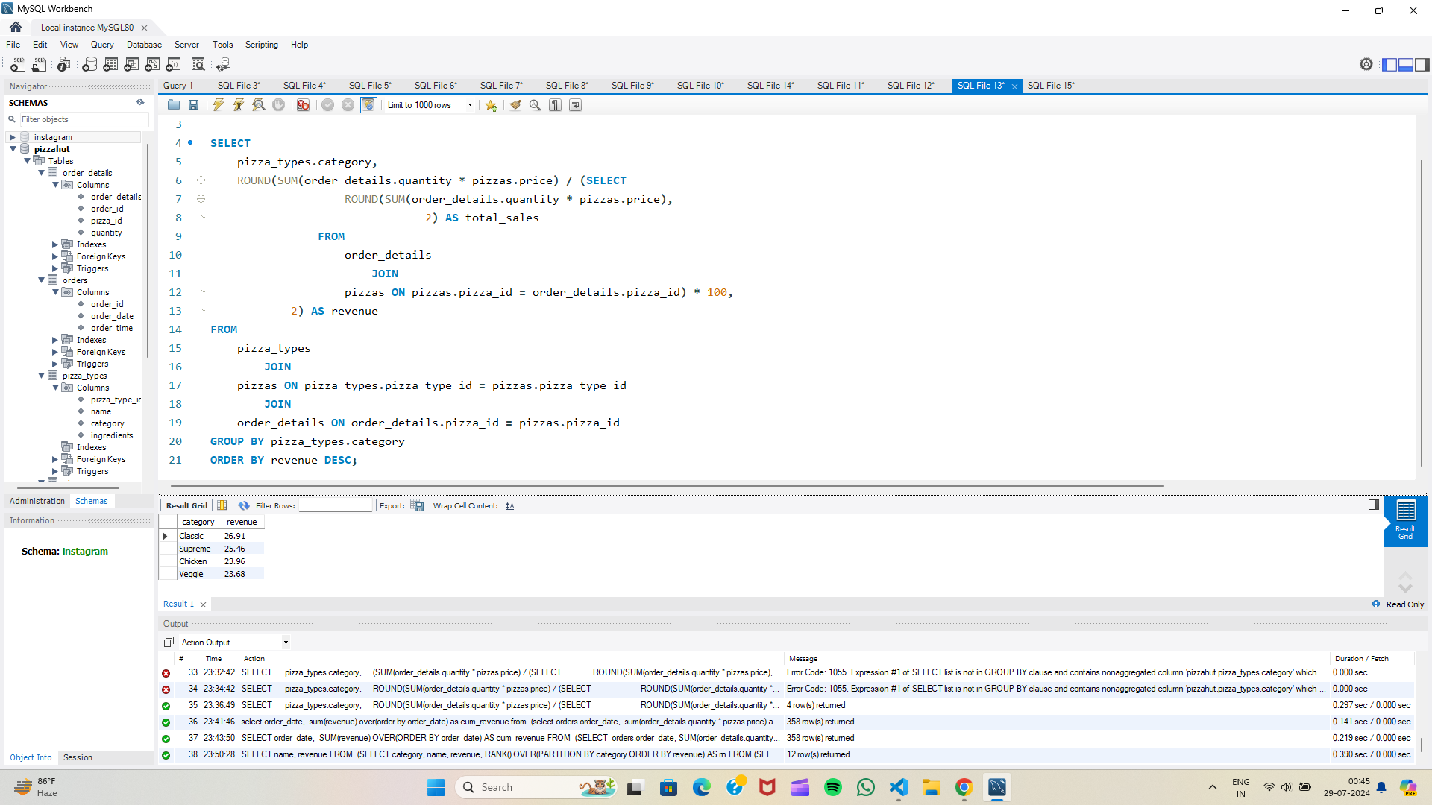
Calculate the percentage contribution of each pizza type to total revenue.

Slide 15
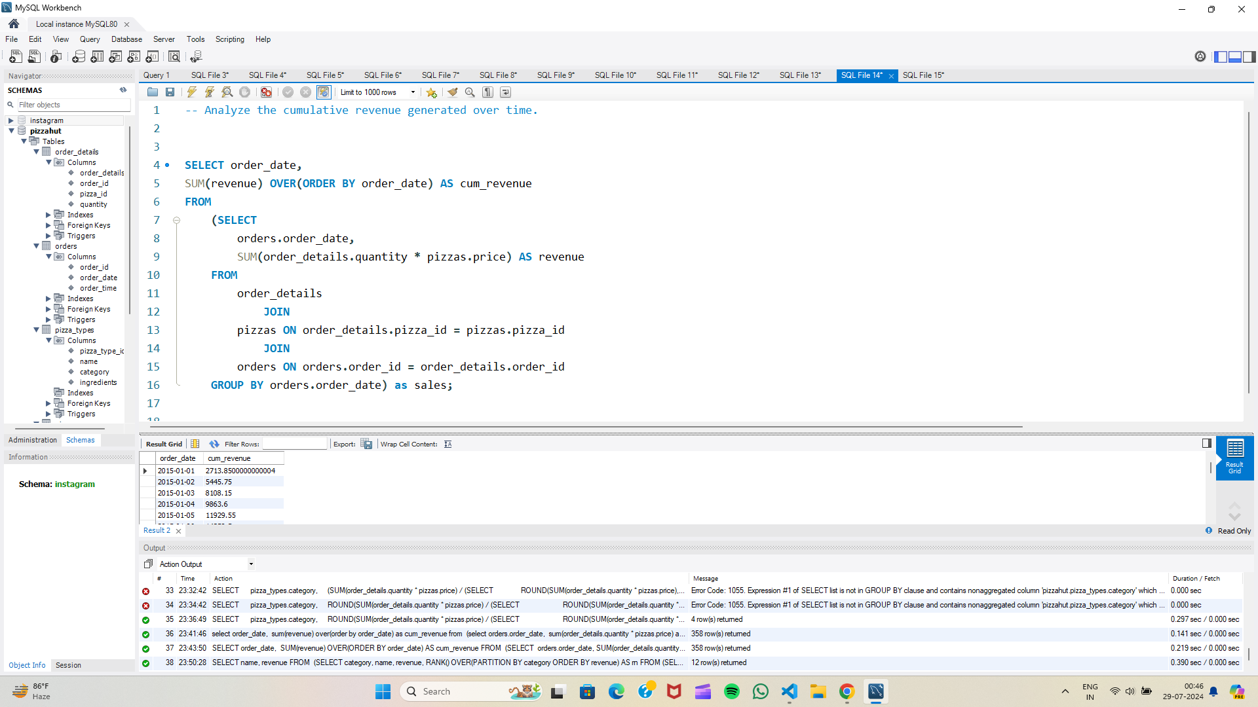
Analyze the cumulative revenue generated over time.

Slide 16
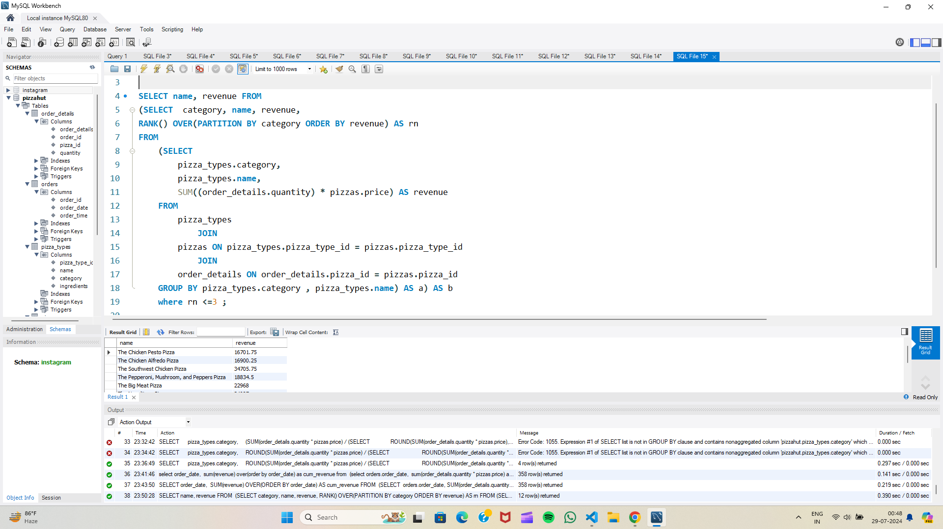
Determine the top 3 most ordered pizza types based on revenue for each pizza category.

Slide 17
KEY FINDINGS & INSIGHTS
Sales Patterns: Determined peak hours and popular order times to optimize operational efficiency.
Customer Preferences: Identified most ordered pizza types and sizes to tailor offerings and promotions.
Revenue Trends: Analyzed revenue contributions and identified top-performing pizza types for strategic planning.
This detailed analysis helps in understanding the sales dynamics at Pizza Hut, enabling informed decisions to enhance business strategies and customer satisfaction.

